Slide 1
Typography
Fonts
This template has been formatted with Salesforce Sans and Avant Garde which are standard fonts set in the Slide Master to avoid compatibility issues.
Slide Titles and Headers
Header text should be set in Avant Garde (demi) have each word capitalized and should be set at 32pt when possible. Use colored text for visual differentiation/focus.
Main topics and subheads should be set at 28pt when possible. Use colored text for visual differentiation/focus.
Body Copy
Body copy should be set to Salesforce Sans (normal) 22pt when possible.
Try to limit each slide to a maximum of 3 font sizes.
Type Tips
Create visual differentiation/focus by using scale and color versus using bullets.

Slide 2

Notes:
We will be discussing future features and functionality, so this is a reminder to please make all of your purchasing decisions based on our existing portfolio and what’s available today.

Slide 3



Spring 2023

Slide 4








How to Automate Your Onboarding Process
Kyle Massey
He/him
Lead Software Engineer
JPMorgan Chase
#DataDevDay

Slide 5
Who Am I?

Slide 6

Speaker Introduction
Kyle Massey
@UpInYourVizness | kyle.massey@gmail.com
DataDev Ambassador
Tableau CoE, Engineering Lead
Automation & UX Specialist
From Cincinnati OH, but lives in Columbus
Alumni of The Ohio State University
Lives with Partner, Dan, and two pets (a dog & a cat)
Loves Gaming, True Crime & House Projects

Slide 7

Speaking of coding with Tableau…

Slide 8

#TableauCoders Initiative User Group
https://www.youtube.com/@tableaucoders
https://datatheories.com/tableaucoders

Slide 9
Onboarding Doesn’t Have to Suck

Slide 10
When Onboarding is a Challenge
You’re a large company with strict separation of duties:
You need to create multiple instances of each project (DEV/UAT/PROD)
You need to create multiple groups per project and assign the correct permissions per environment
You’re a small company with limited or no L1/L2 support:
The process can be time-consuming and prone to human error
You need or want to onboard multiple projects quickly
You anticipate your company’s usage of Tableau Server/Cloud growing quickly

Slide 11
A look at the “old way” of doing things..

Slide 12
Now let’s automate!

Slide 13
Tools we’ll be using
Python
Flask – a lightweight library for building APIs
https://palletsprojects.com/p/flask/
Tableau Server Client (TSC) – Tableau’s official Python library for interacting with the REST API
https://tableau.github.io/server-client-python/docs/
Vue.js
Javascript framework for creating single-page applications (SPA)
https://vuejs.org/
Vuetify
Prebuilt components for use with Vue that conform to the Material Design standard
https://vuetifyjs.com/en/
Github:
All of today’s code/examples will be available – steal away!
https://github.com/kjmassey

Slide 14
Demo/Code Review

Slide 15
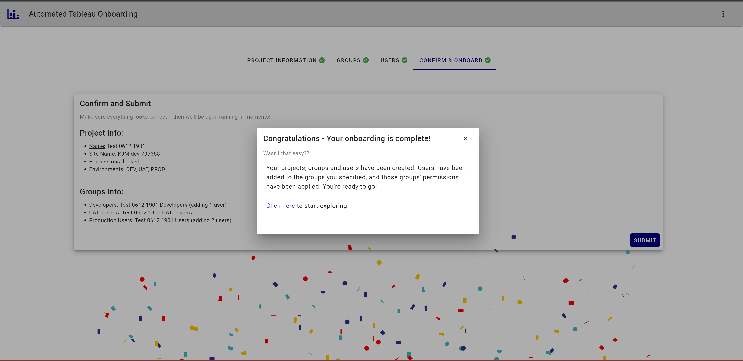

Slide 16
Q&A

Slide 17
Additional Resources

Slide 18
Additional Resources for DataDevs
Tableau Developer Program
Get your free Developer Sandbox site and get coding!
http://tableau.com/developer
Tableau REST API Documentation
Tableau’s REST API is incredibly powerful – you’ll use these docs a lot if you’re looking to automate!
https://help.tableau.com/current/api/rest_api/en-us/REST/rest_api.htm
Tableau REST API Postman Collection
A preformatted collection of requests in Postman for interacting with the REST API!
https://www.postman.com/salesforce-developers/workspace/salesforce-developers/collection/12721794-7d783742-165f-4d10-8c4c-5719fb60fba2?action=share&creator=13750038
Tableau Embedding Playground
Get drag-and-drop code snippets for embedding Tableau content in a web application!
https://developer.salesforce.com/tools/tableau/embedding-playground
#TableauCoders Initiative
Zak and I co-lead an entire TUG on this stuff – come join us! ☺
https://www.youtube.com/@tableaucoders
http://datatheories.com/tableaucoders

Slide 19



Thank you
Twitter @UpInYourVizness

